Slide 1
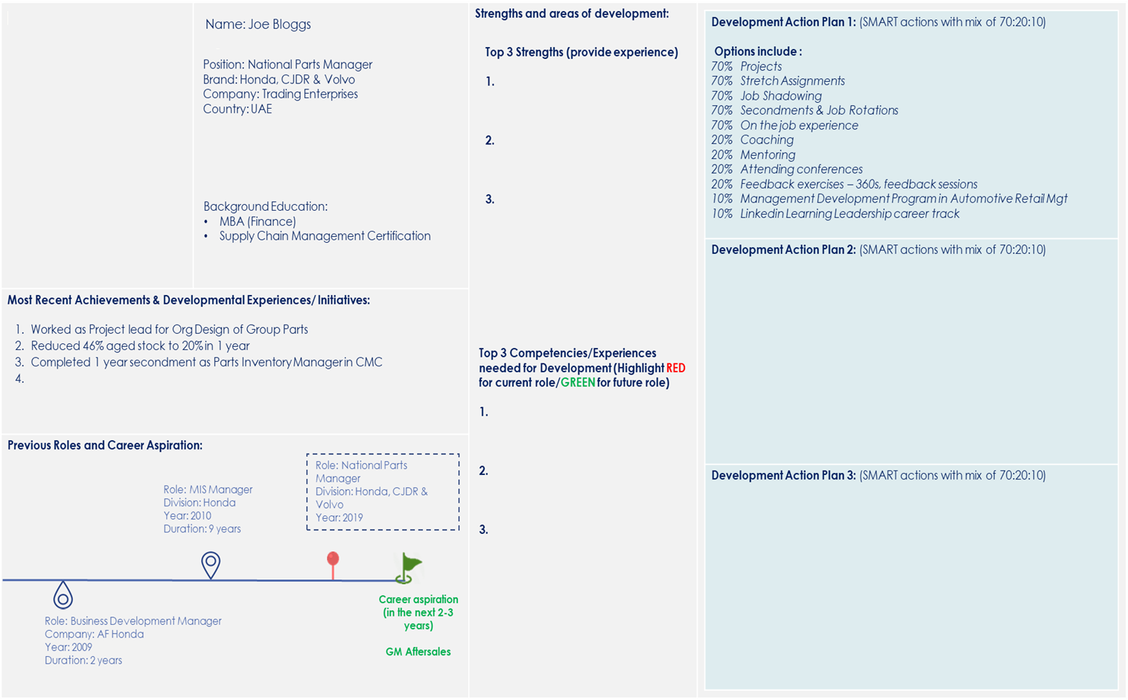
Career Growth & Development Template Example
IDPs available for all associates
2 types of IDP
1. Development in current role
Orange pin represents current role
2. Development towards future role
Green flag represents future role
70:20:10 development must be developed by the associate to ensure accountability of their own development – HRBPs and management support to enable opportunities for development through launched mechanisms

Slide 2


Career Growth & Development Template |  | Strengths and areas of development:
Most Recent Achievements & Developmental Experiences/ Initiatives:
Previous Roles and Career Aspiration:
Name:
Development Action Plan 1: (SMART actions with mix of 70:20:10) Options include : 70% Projects 70% Stretch Assignments 70% Job Shadowing 70% Secondments & Job Rotations 70% On the job experience 20% Coaching 20% Mentoring 20% Attending conferences 20% Feedback exercises – 360s, feedback sessions 10% Management Development Program in Automotive Retail Mgt 10% Linkedin Learning Leadership career track Link your activities together to provide rich learning journey
Development Action Plan 2: (SMART actions with mix of 70:20:10)
Development Action Plan 3: (SMART actions with mix of 70:20:10)
Position:
Brand:
Company:
Country:
Top 3 Strengths (provide experience)
1.
2.
3.
Background Education:
Top 3 Competencies/Experiences needed for Development (Highlight RED for current role/GREEN for future role)
1.
2.
3.
Role:
Manager
Division:
Year:
Role:
Division:
Year:
Duration:
Career aspiration (in the next 2-3 years)
(Add Title)
Role:
Company:
Year:
Duration:

